Slide 1
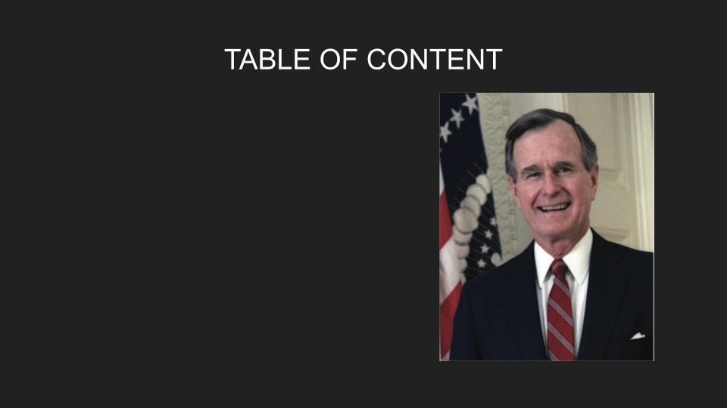
Image Sort
Image Word Web
Keyword/Who Said That?
Keyword/Who Said That: Reference Material
Challenge Edition: Key Word Activity
Challenge Edition: Reference Material
  Letter 1
  Letter 2
  Letter 3
Pillars to Live By

Slide 2
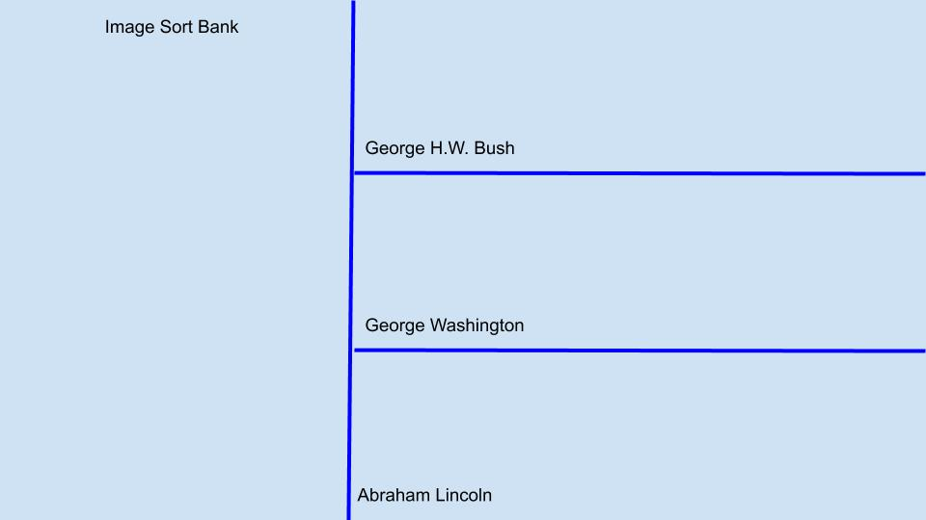
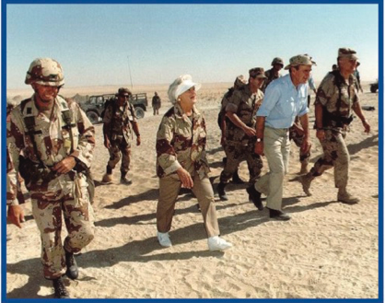
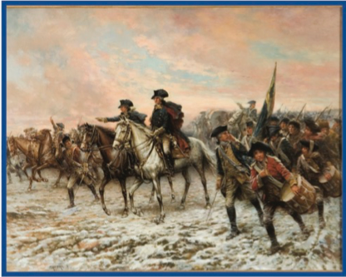
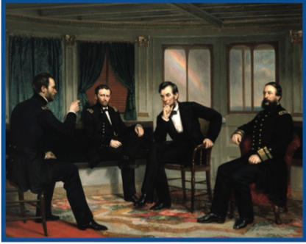
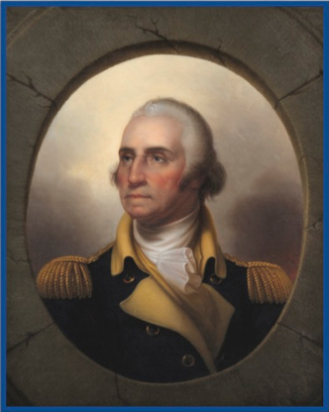
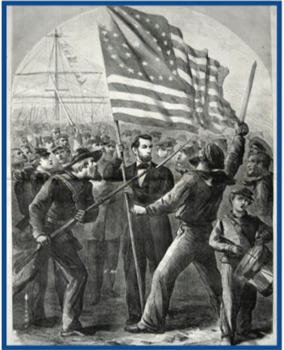
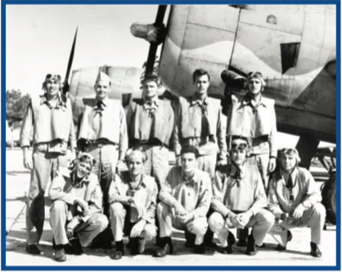
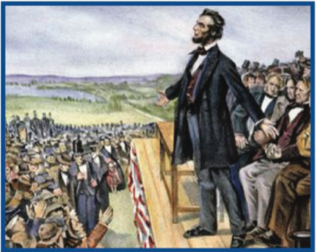
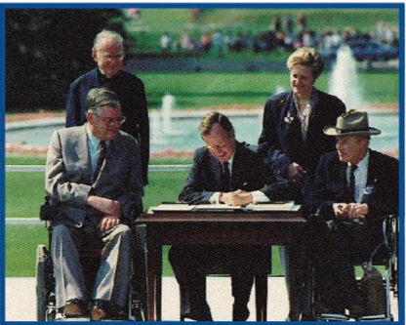
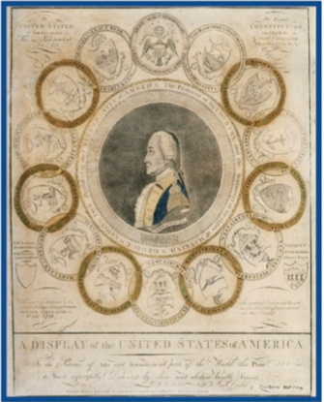

Slide 3
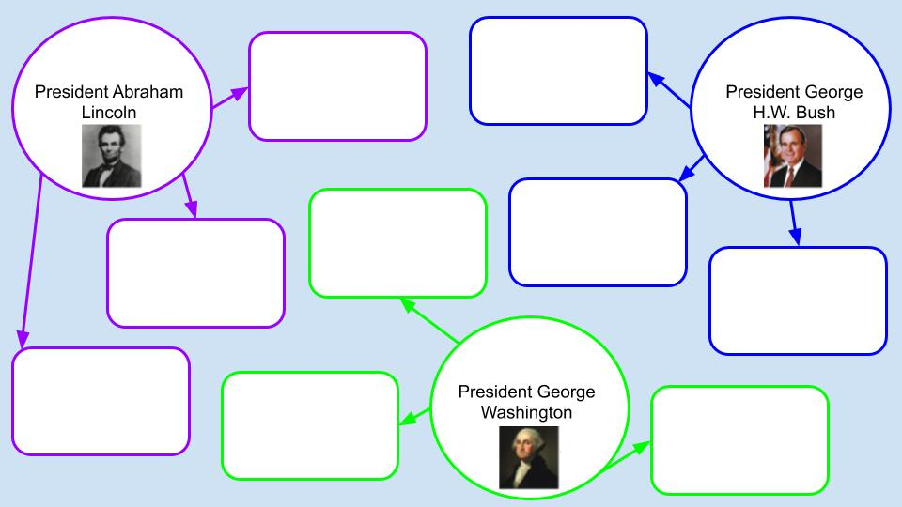
[Type here]
[Type here]
[Type here]
[Type here]
[Type here]
[Type here]
[Type here]
[Type here]
[Type here]

Slide 4
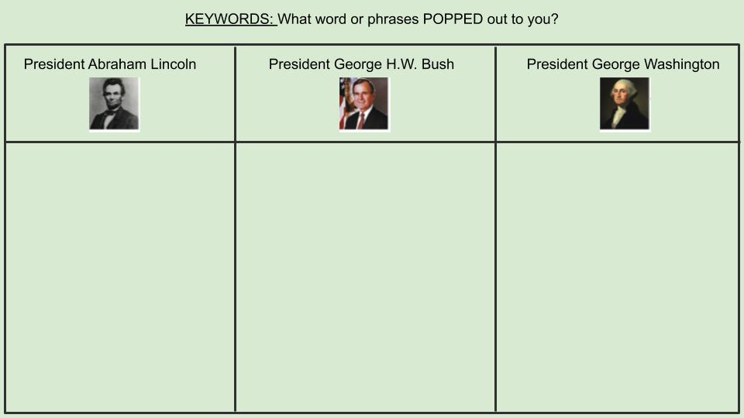
[Type here]
[Type here]
[Type here]

Slide 5
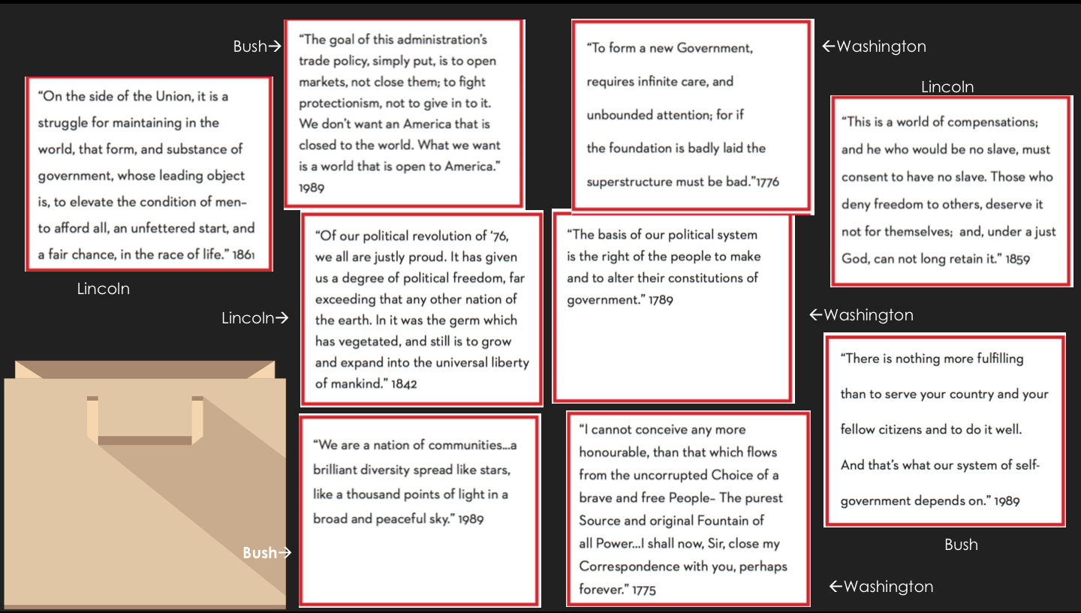

Slide 6
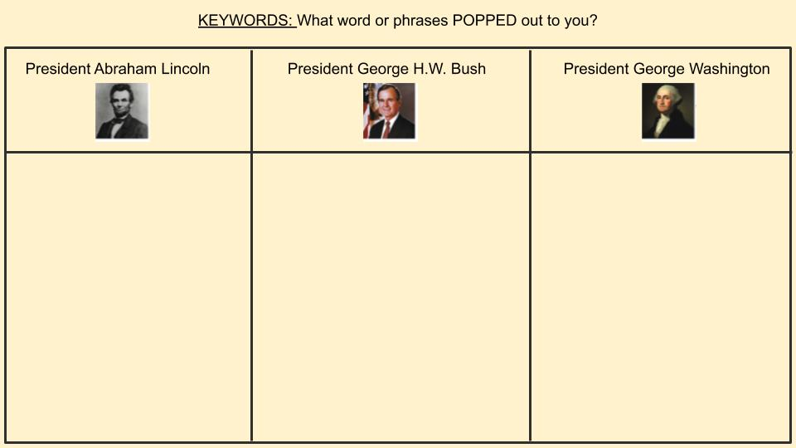
[Type here]
[Type here]
[Type here]

Slide 7
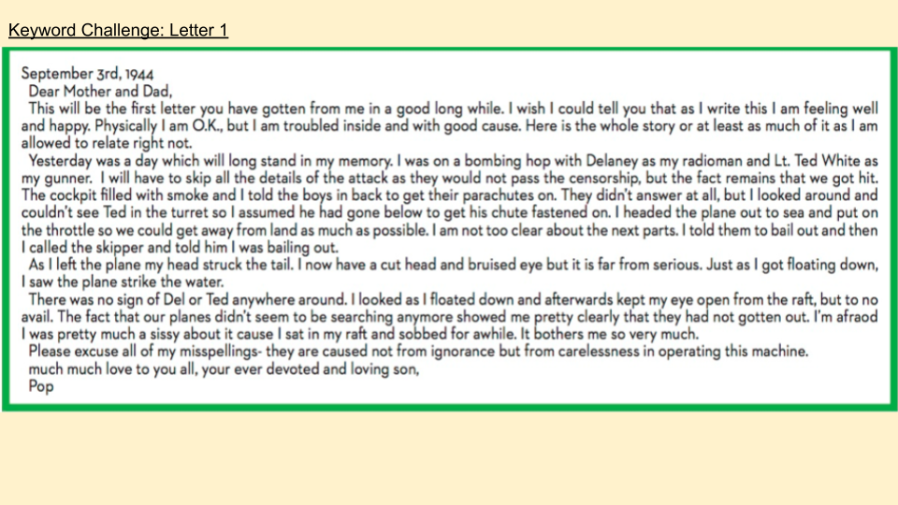
[Type keywords here]

Slide 8
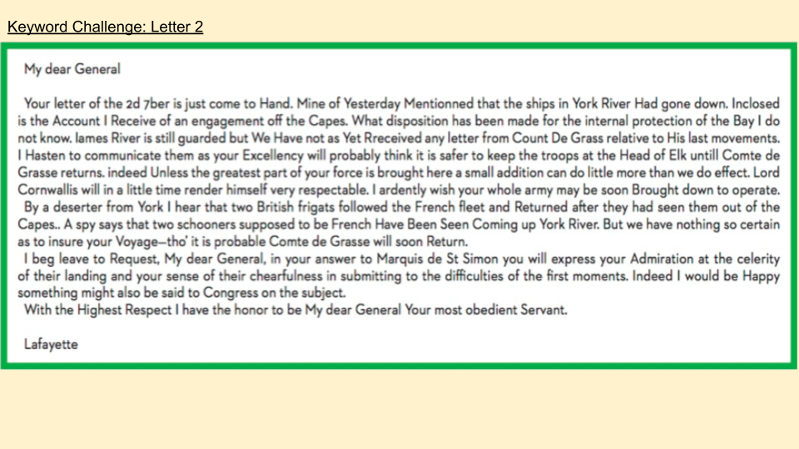
[Type keywords here].

Slide 9
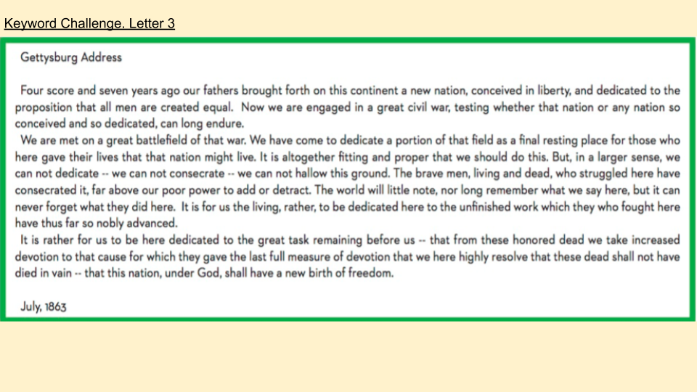
[Type keywords here]

Slide 10
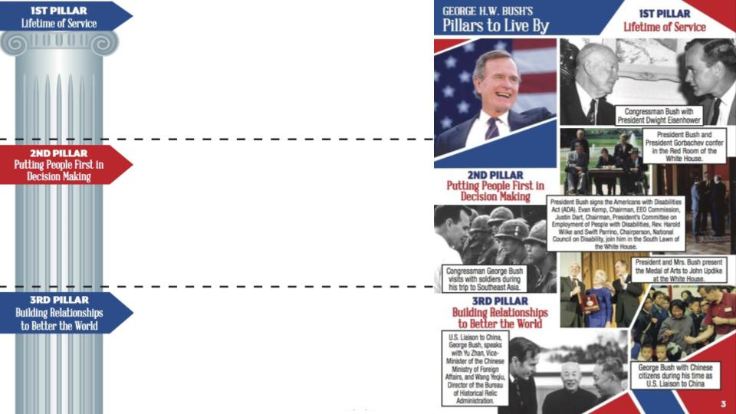
[Type here]
[Type here]
[Type here]

